Slide 1
Smart Compost Bin
Summer 2023 Meeting

Slide 2
Personnel
Hardware Team (Jason)
Rishabh
Devashree
Mohan
Ryan
Daniel E.
Jake
Landscape Team (Quincy)
Janita
Valeria
M
Disha
Cloud Team (Patrick)
Aidan
Kim
Micah
Daniel L.
Computer Vision (Patrick)
Pratik

Slide 3
August 2nd, 2023
Summer Meeting 6

Slide 4
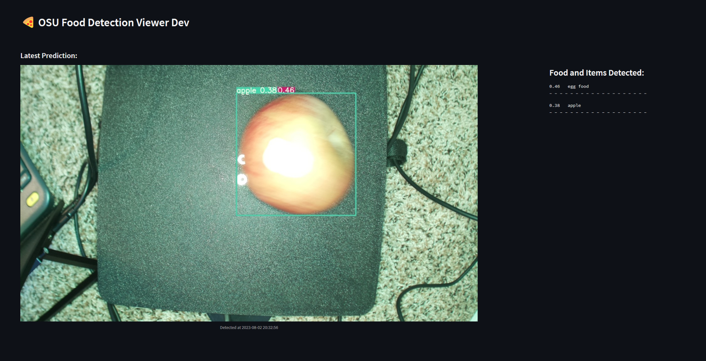
Cloud
Pi -> Nano Migration
Cloud Infrastructure
Detection API successfully rebuilt
Database restoration
Identified ~167 images from MySQL
Working on recovery workflow ✅

Slide 5
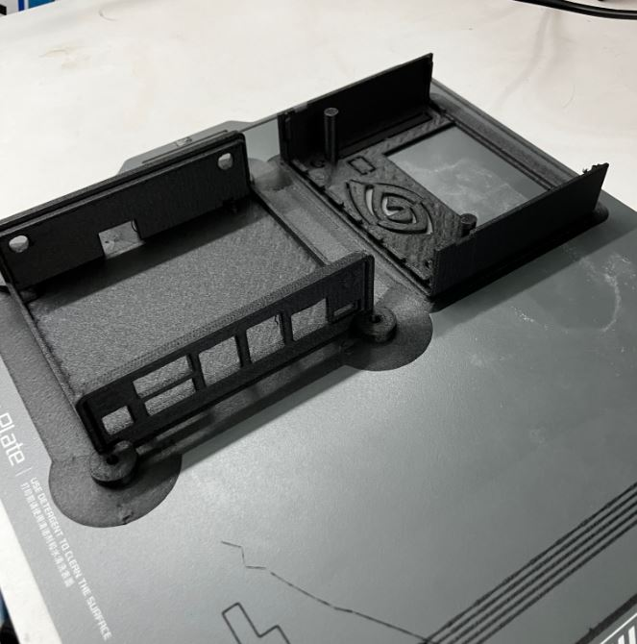
EE
Mostly waiting on feedback for V2,
Bambu X1 Carbon has been delivered and set up in the Clark Lab so we can now rapidly iterate through prototypes, here is our newest case printed today out of ESD safe Carbon Fiber

Slide 6
Ag/Lit Team
Overview:
refining and focusing our literature search on supporting strategies that inform the design, implementation, assessment, and education of the smart composting bin
Focusing on understanding consumers’ behaviors
Aligned our team to focus on the following:
Consumer Behaviors and Attitudes toward FLW
literature tells us that a better understanding of consumers' behaviors and attitudes toward food waste is essential for devising effective strategies for waste reduction.
Contextual Factors
These include household size, urban versus rural location, cultural habits, dietary preferences, government assistance
we are finding that contextual factors can significantly influence the levels and types of food waste.

Slide 7
Ag/Lit Team
Literature findings:
Religious aspects - restrictive religious norms lead to greater food waste vs supportive religious norms lead to reduced food waste
Shopping habits - Buying food items repetitively that are not typically consumed by a particular household which leads to greater food waste
Diet and fitness - healthier diets and fitness leads to more food waste
Ignoring expiration dates - the difference between ‘best before’ vs ‘expiration date’
Income brackets - low income families produce less food waste
Next Steps:
While broadening our search, we are still analyzing data on the measurement of FLW
Continued reporting on consumer behaviors to inform smart composting bin's design, implementation, assessment, and education.

Slide 8
July 26, 2023
Summer Meeting 5

Slide 9

Computer Vision
While looking for food waste data sets, I came across different Food Waste Management tools. All of them are most likely commercial, proprietary tools, so expecting data from them might not be worth it. But, if you haven’t looked at them already, it’s interesting to see most of these tools having similar goals as well approaches.
Winnow Solutions : Seems like a popular tool as I have seen many articles write about it. Found here, also in FoxNews
FloWaste : Discovered from this article, they’ve now changed to FloVision
Phood Solutions : Looks sophisticated with touch screen system, read first here
Lufthansa also working on their own proprietary system, here
Orbisk : The short demo video looks cool, read here
Nuvilab : Real time scanning of commingled food and detecting individual food items on the plate along with the calorie and weight estimation data. Read here
Orbisk

Slide 10
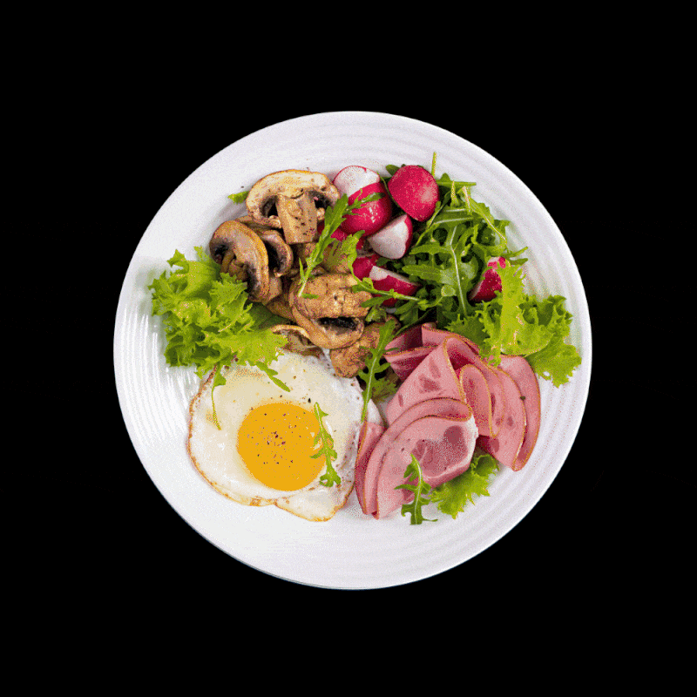
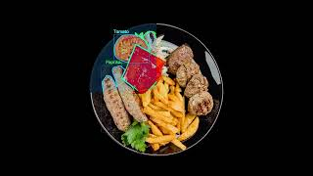
Computer Vision
Nuvilab (Food segmentation with calorie and weight estimation)

Slide 11
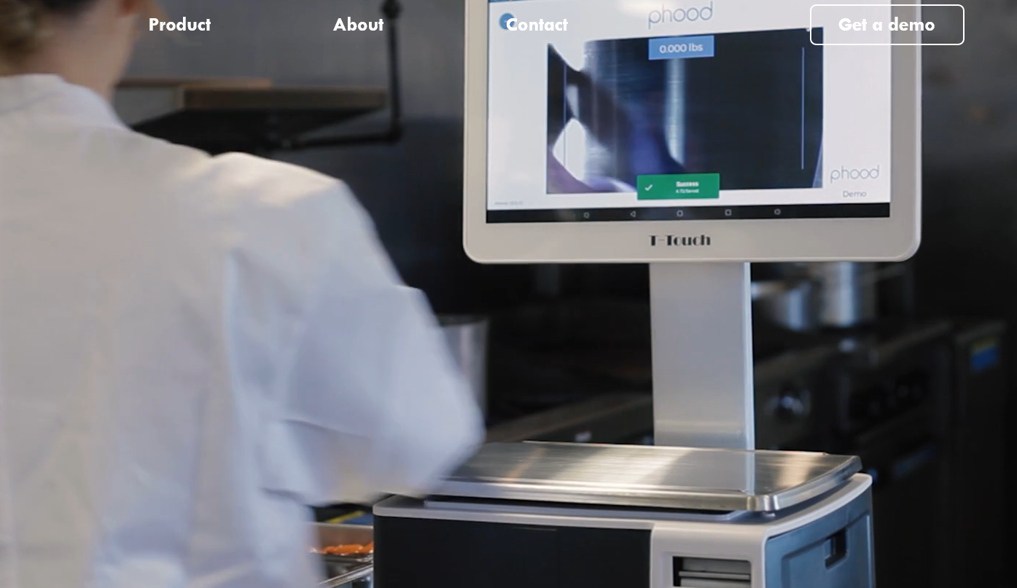
Computer Vision
Phood Solutions (Weigh scale, camera, and touch screen assistance)

Slide 12
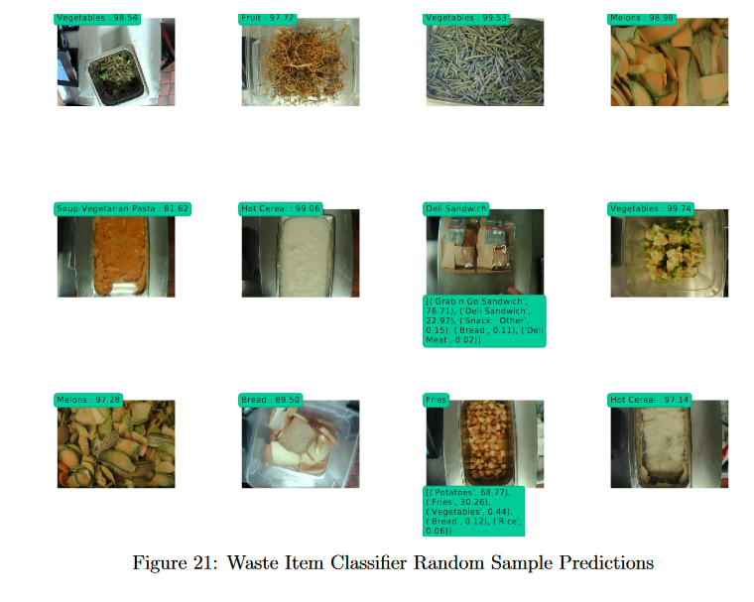
Computer Vision
Might be helpful for the Lit. Review team – Portland State University student has done similar food waste detection project:
They say that they gather data from their “customer sites”
In total, there are 52 distinct waste item names and 55 distinct container classes in the metadata.
55k images, find the thesis paper here

Slide 13
Ag/Lit Team
We are analyzing literature and data to answer some initial questions in support of refining and focusing our literature search efforts to inform design, use, implementation, assessment, and education of a smart composting bin.
Example guiding questions include:
How does literature support or not, data driven strategies that may inform…?
Smart bin design, use, implementation, assessment, and education
How does literature inform or not…?
Household composting and FLW strategies, i.e., measurement, use for compost, education about the how and why of it all
Reflective interventions to influence consumer behaviors
Mobile app interventions that support tracking personal FLW
We are also looking at how some of the larger databases can inform design, use, implementation, assessment, and education.
For Example:
Food and Agriculture Organization of the United Nations (FAO): http://www.fao.org/food-loss-and-waste/en/
World Bank: World Bank: https://data.worldbank.org/
US Department of Agriculture (USDA): https://www.ers.usda.gov/data-products/food-loss-waste-databases/

Slide 14
Ag/Lit Team
We are identifying and reaching out to those companies that developed Smart bins that not only measure FLW but identify food as well.
Guiding questions here are…
How do they identify foods
Cost of their product
How their product is trained
Accuracy of food identification
Savings to the customer
One Example here is….
Winnow https://www.winnowsolutions.com/company
A commercial food waste management company have created smart bin technology that collects images and measures FLW with clients such as:
Contract catering
Hotel and resorts, like Four seasons
Cruise ships
Casinos
Retails, like IKEA

Slide 15
Ag/Lit Team
Here is what literature and data is telling us
More data based on direct measurement is needed
Only about 20% of the studies in the literature are based on direct measures of food waste
None of the studies measuring household FLW use imaging
Studies that address FLW are disproportionately sample affluent
Some gaps in literature include…
Quantification and Data Accuracy
Waste Composition
Contextual Factors
Behavioral Insights

Slide 16
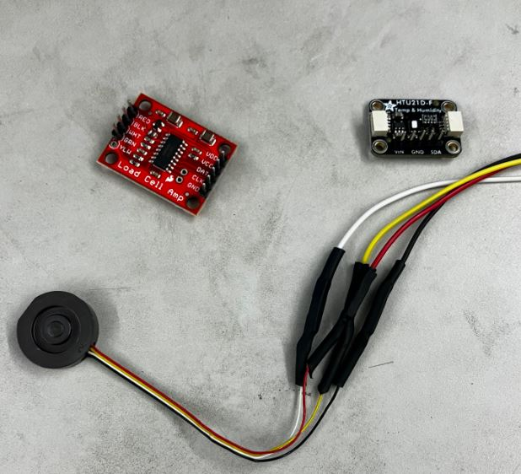
EE
All devices have arrived, the last device to arrive was LiDAR on monday.
All devices in hand have been soldered and prepared for each build (photo on the left is an example of chips soldered with pinouts and jumpers)
2 complete V0’s have been built and one V1 is in process, waiting on housing and a bin model from cascade team
A Carbon Fiber printer is being delivered to our lab so we can run many prints across many locations

Slide 17
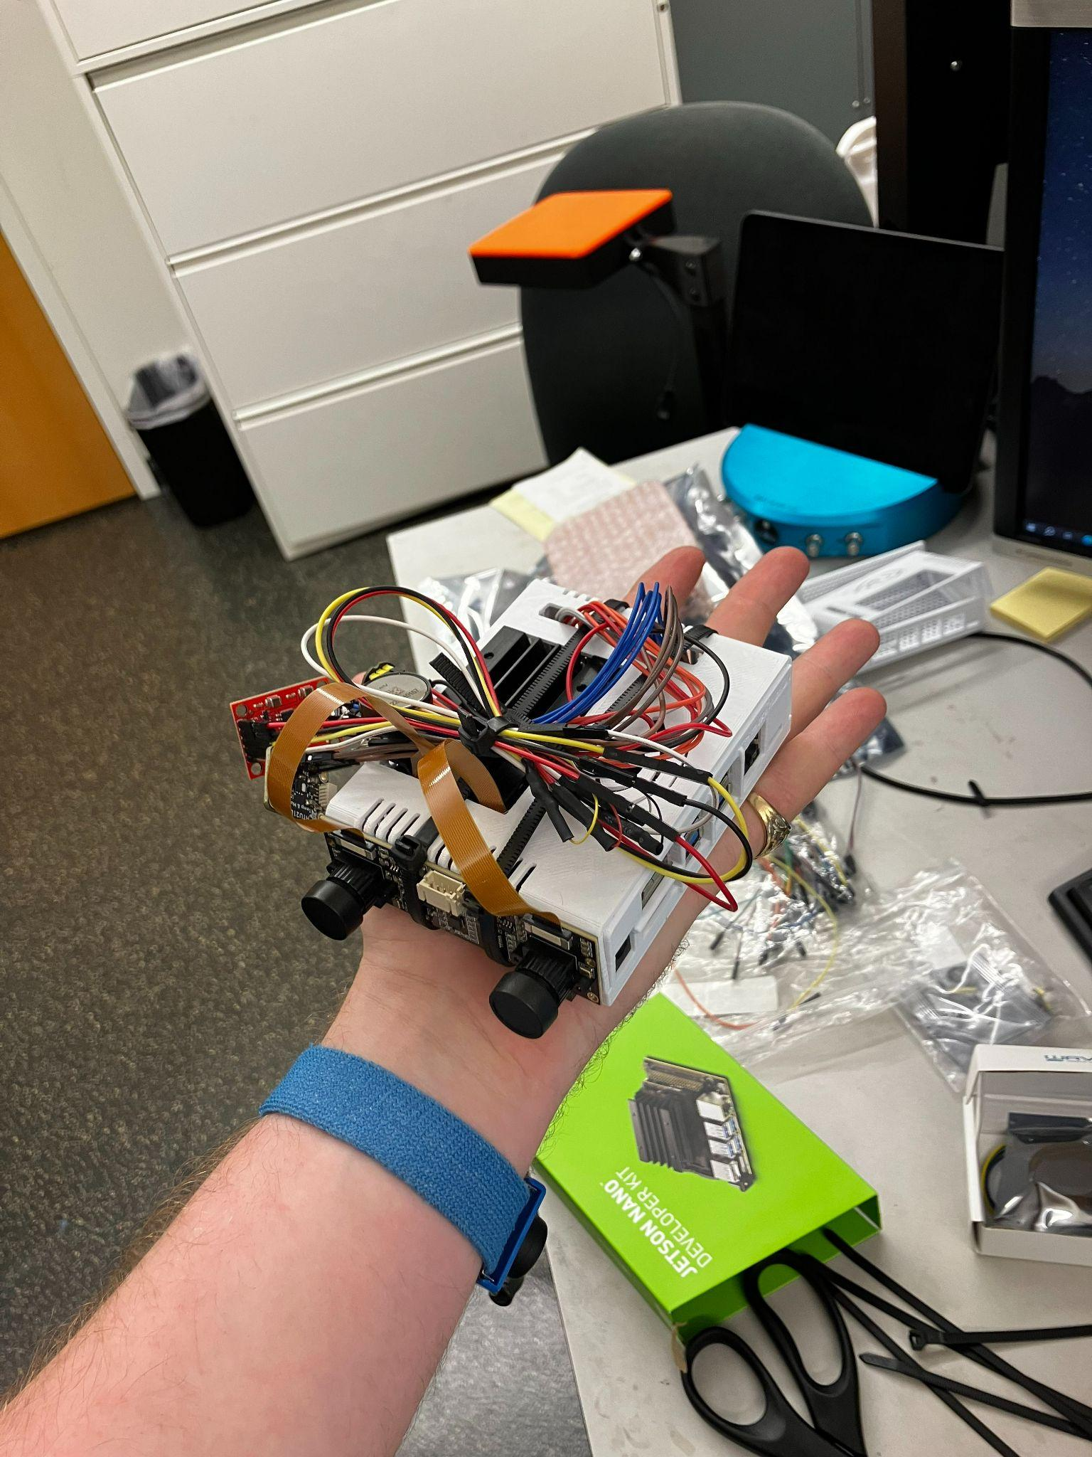
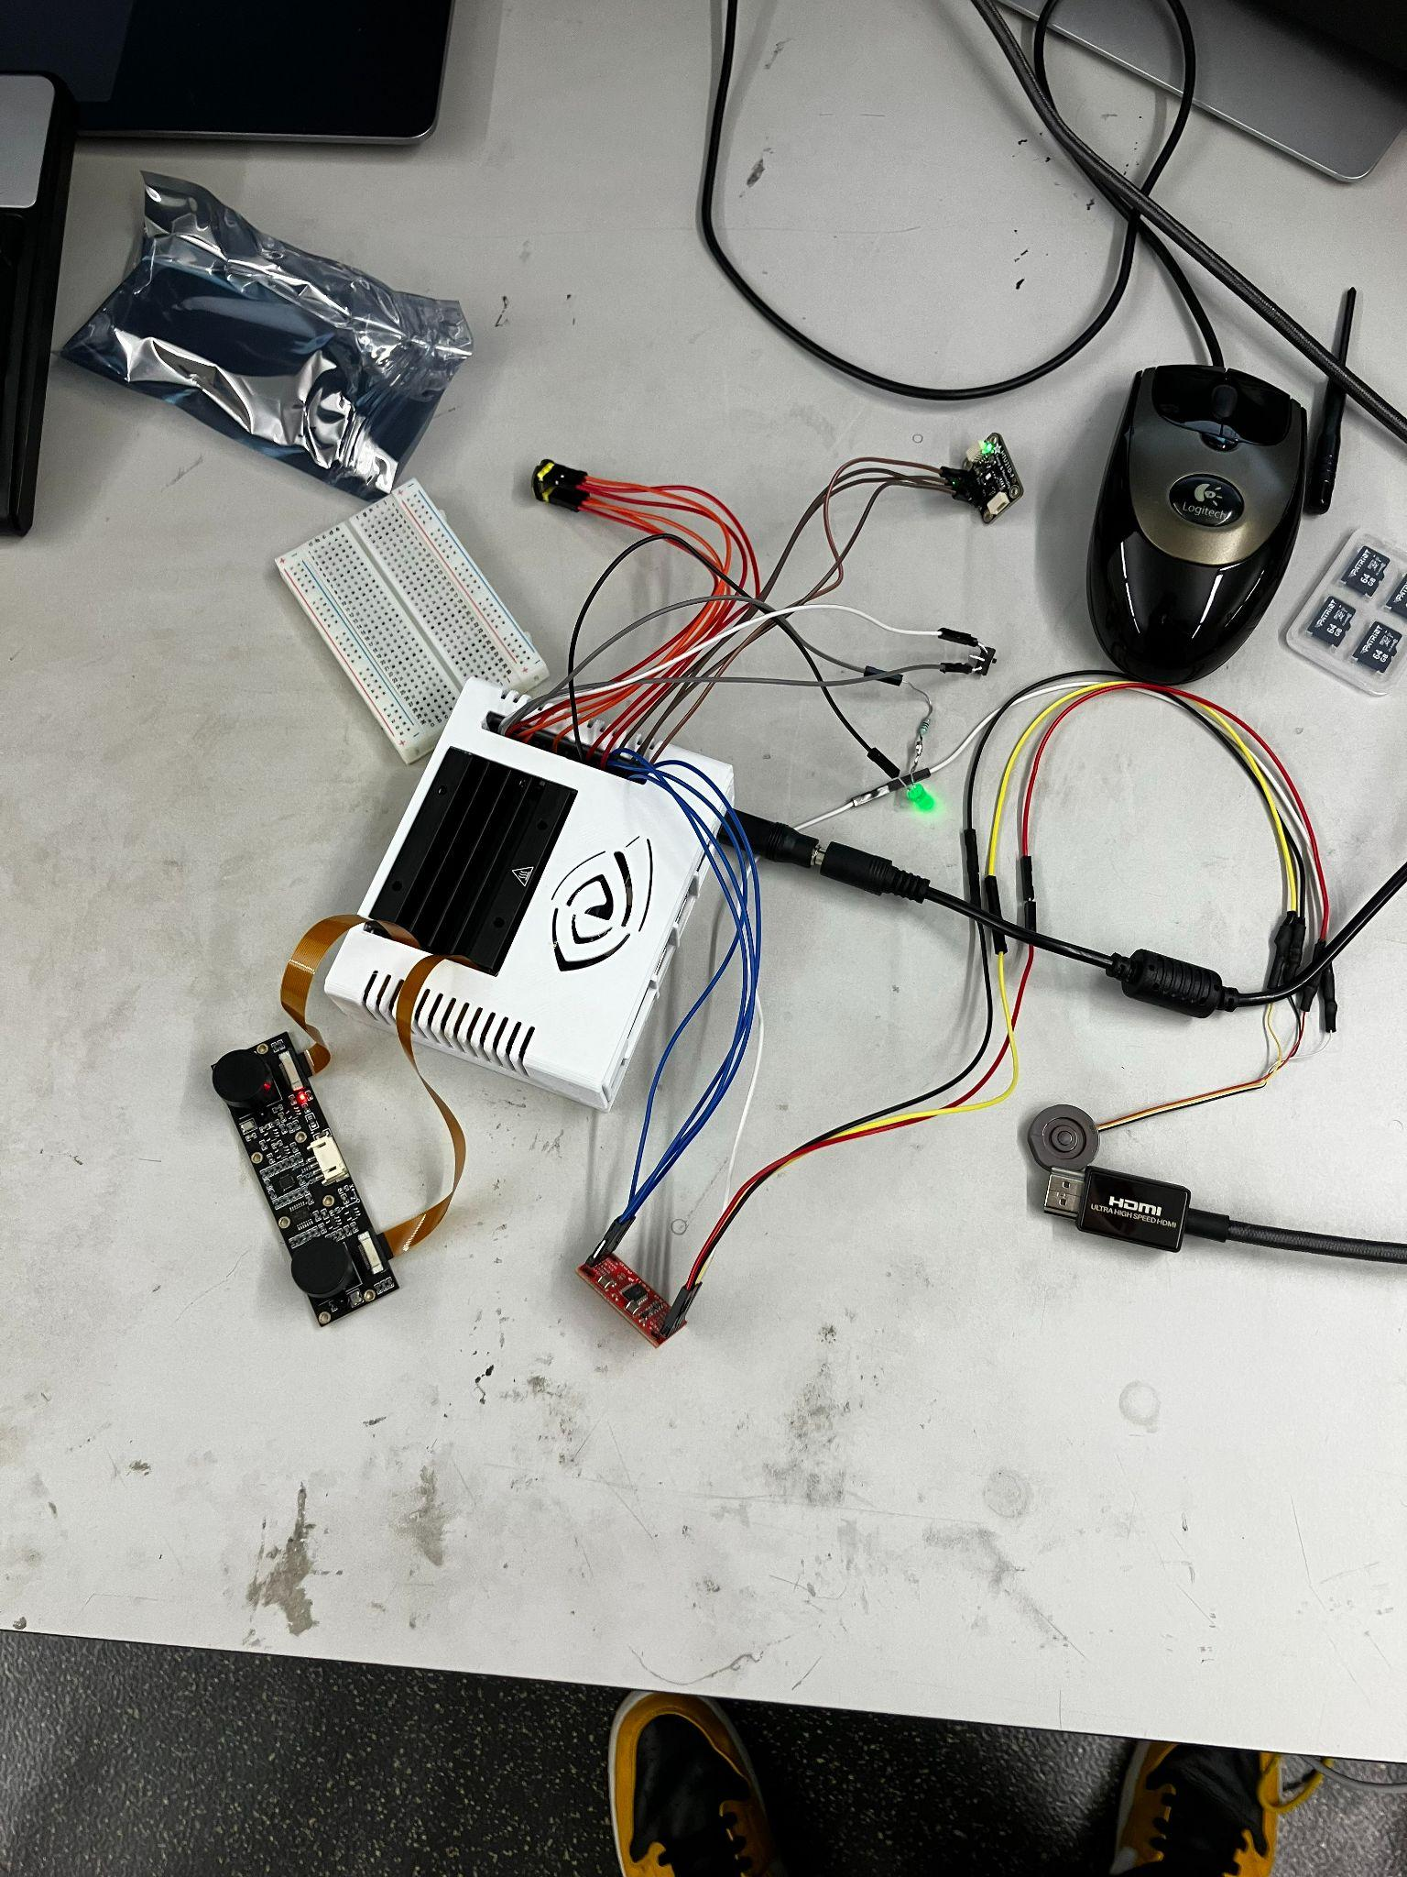
EE
V0 has been assembled and moved down the line of development.
V1 with LiDAR is being tested with Mohan
V0 is being sent to developers in California.
Most to all of the sensors auto interfaced
As shown in this photo
Testing is on its way we
Are debugging scripts.

Slide 18
Cloud
Continued preliminary pi -> Nano migration
Hardware shipped
Build AWS dev environment
Identified database schema/cost overrun issue
Migrating data store to S3

Slide 19
July 19, 2023
Summer Meeting 4

Slide 21
CS Team
Cloud Team
Cloud Investigation
Centralized repository
Docker exploration
FastAPI + Streamlit
Todo
Documentation
Database Schema
EC2 + RDS dev environment
Embedded Team - In Progress
Jetson Migration
Button Logic
Sensors Integration
Cafeteria Food Waste Device V3
CAD In Progress
Components on order
Jetson Migration

Slide 22
Lit Team
Progress Update:
Staying on course and working towards achieving our initial objectives and extracting relevant data from literature
Students will continue to focus on critical reviews - which will cover more literature in one article
Upcoming Evaluation (July 28th and 31st):
The goal of these meetings is to asses the literature we have reviewed so far.
A full Ag Team meeting on July 31st to collectively evaluate our progress and assess where we are.
In the meeting we plan to:
Analyze the reviewed literature to identify any emerging patterns or trends.
Evaluate our current goals and course correct (if necessary) to ensure our objectives still align with the insights we found so far.
Discuss the layout and organization of the paper we intend to write and also identify themes within the literature that will help us structure our paper.

Slide 23
July 12, 2023
Summer Meeting 3

Slide 24
CV Team
I searched for more commingled food and food waste data sets and came across some new ones, but interestingly almost all the data sets found on Roboflow seem like they share the same data source.
I have created a spreadsheet for different data sets (primarily food waste) foundly publicly. Food Waste Data Set U23
Roboflow is specialized to work with computer vision tasks where we can upload image data sets, annotate them, create a model to train them, deploy the model, write API code for data accessibility. Also, they provide the ‘Health Check’ feature to generate data distributions, heatmaps, etc. For the annotation task, the Roboflow Annotate Tool seems to be a great option.
I downloaded the food waste data from Roboflow and created a new project in their portal.
They provide a way to upload the dataset folders and once the data is read, it gives you the option to add or remove classes, bounding boxes.
It also shows you the unannotated images which you can label before uploading.

Slide 25
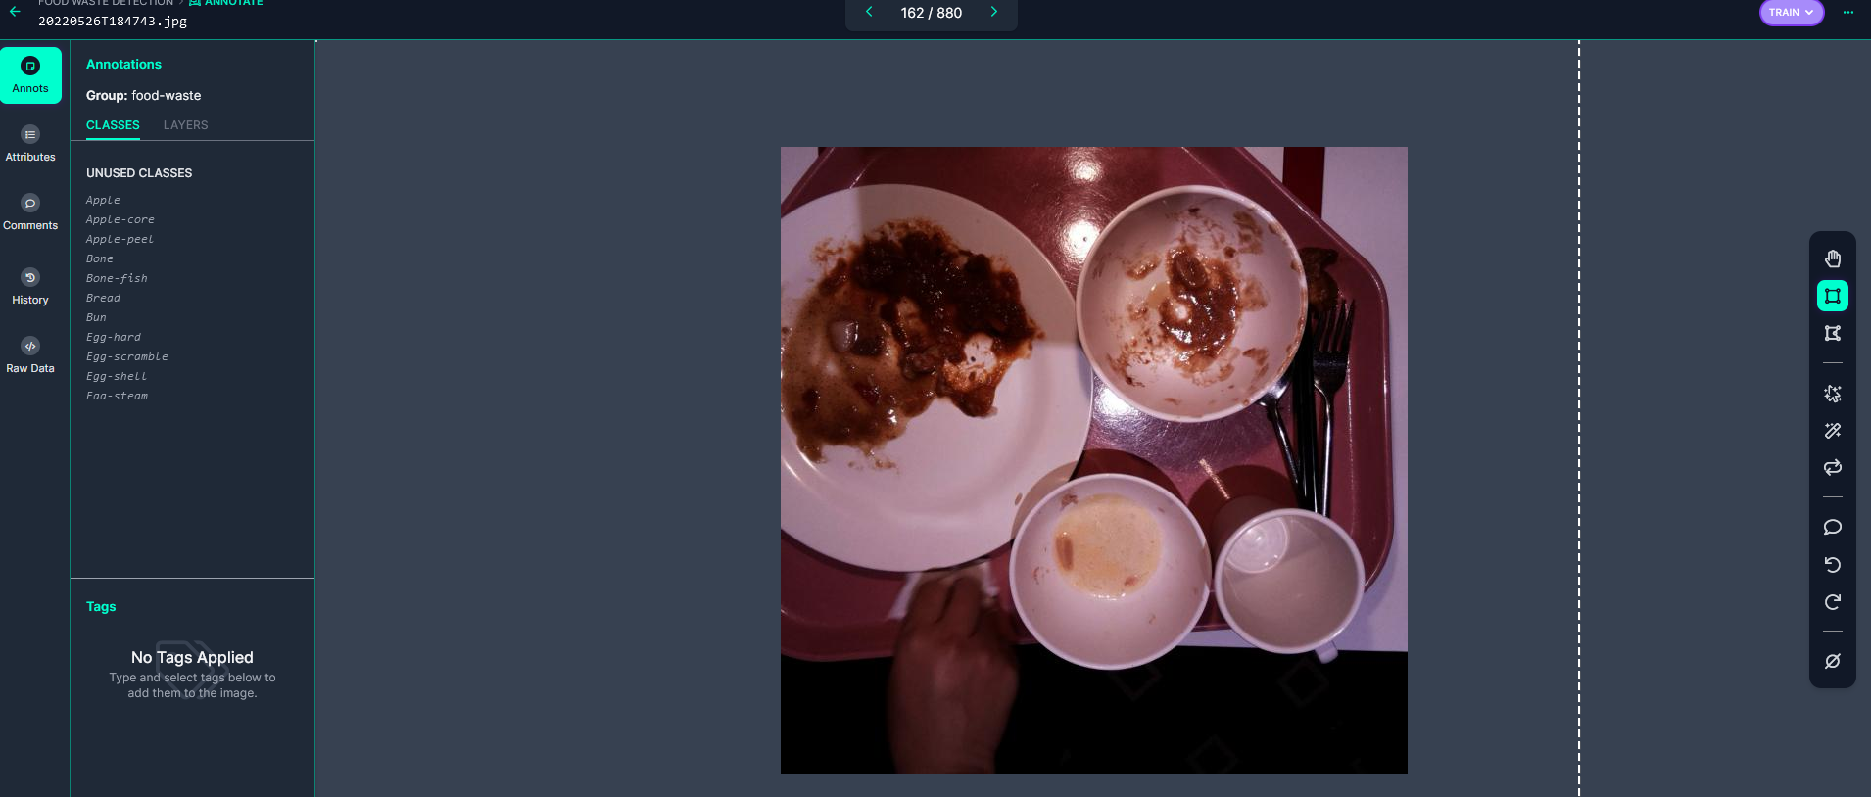
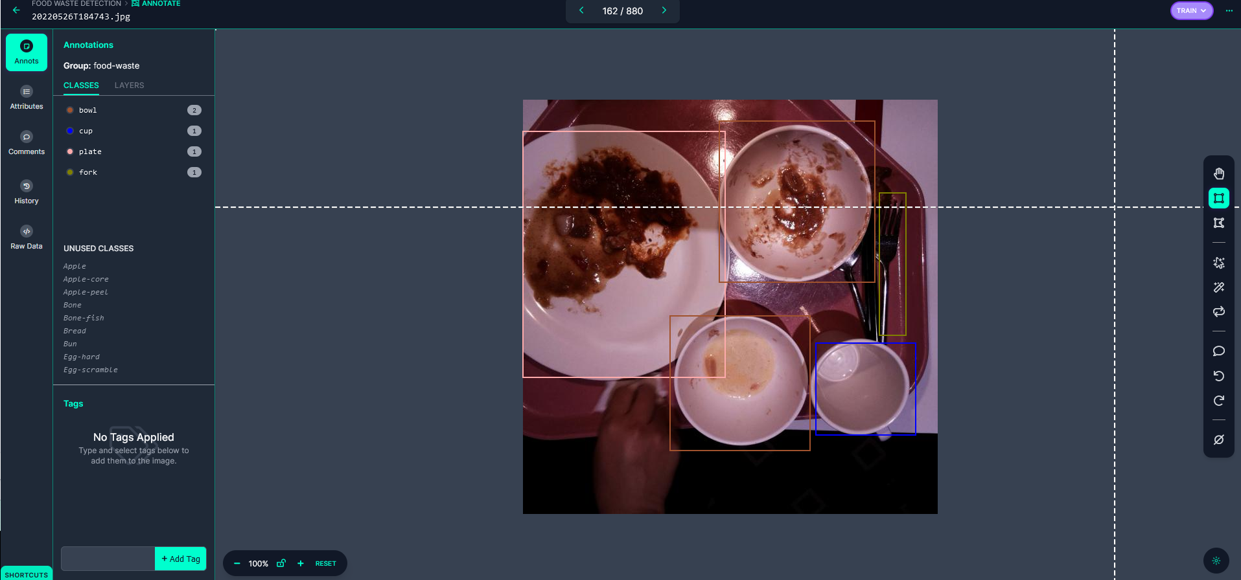
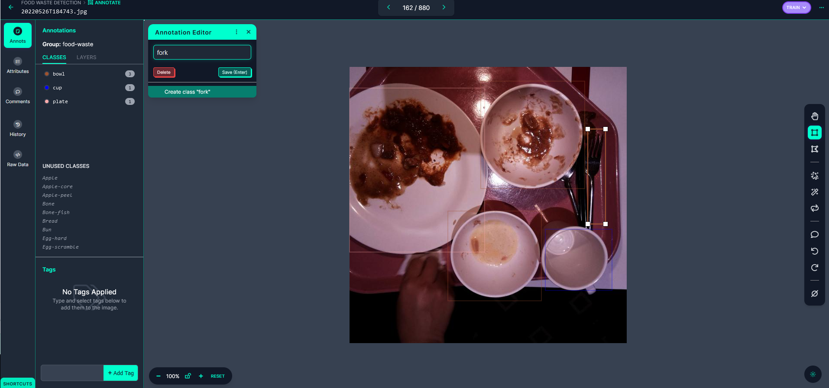
Food Waste Data Set U23
Images:
Topleft: Before labeling
Topright: After labeling
Bottom: New class fork added

Slide 26
Lit Team
Literature search and selection in place
Skeleton for the excel sheet finalized
Target: 10 articles per student per week (can be changed depending on the team’s efficiency)
Literature search begun
Selection criteria:
Date: 2010 - present
Type of measurement: Consumer waste (while keeping an eye out for other useful articles students might come across)
Demographic: US household (while collecting literature from other countries on the side to help aid the design)
Publication type: Peer-reviewed journal articles and grey literature
Method: Focus on articles that use journal approaches and direct measurement while also including any other food waste measurement methodologies that might prove to be useful for the purpose of this study.
Initial findings and insights:
Found a good amount of international articles that focus on household food waste
Capturing data that is uncovering consumer behavior towards food loss and waste.
Also plan on collecting blog posts, white papers and other non-peer reviewed literature that might identify usage of emerging technology used to measure household food waste

Slide 27
CS Team
Cloud Team
Cloud Investigation
Access to AWS + OSU filespace
SSH Keys
Recovered Docker file
EC2 instance running Docker
Streamlit
FastAPI
FastAPI + AWS RDB via boto3 connector
CV + Cloud Team Meeting
Walkthrough of server code
In Progress: Unify server code repositories
In Progress: Document RDB schema
Commercial Food Waste Device V3
Investigated GPIO and i2c bus of jetson nano
6 i2c registers, 4 available
Similar GPIO availability and pinout

Slide 28
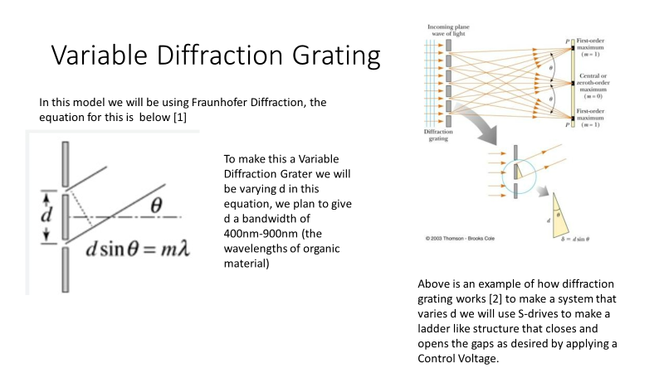

Slide 29
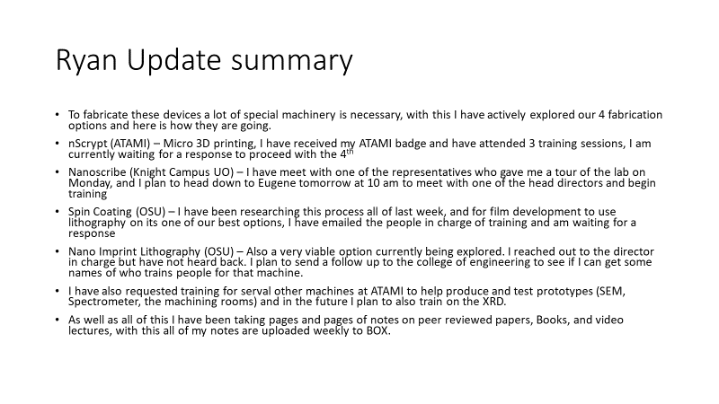

Slide 30
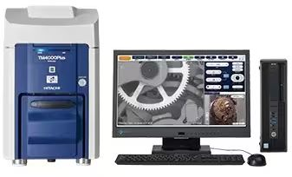
EE Team
Three Raspberry PI 4s have been picked up and we now have a schematic.
Further fabrication efforts towards the Variable Diffraction Grater have been made. (Nanoscribe training)
I am now certified to use the Hitachi SEM at ATAMI. This come with a spectrometer built in to it so we can have comparative data for when we have samples.

Slide 31
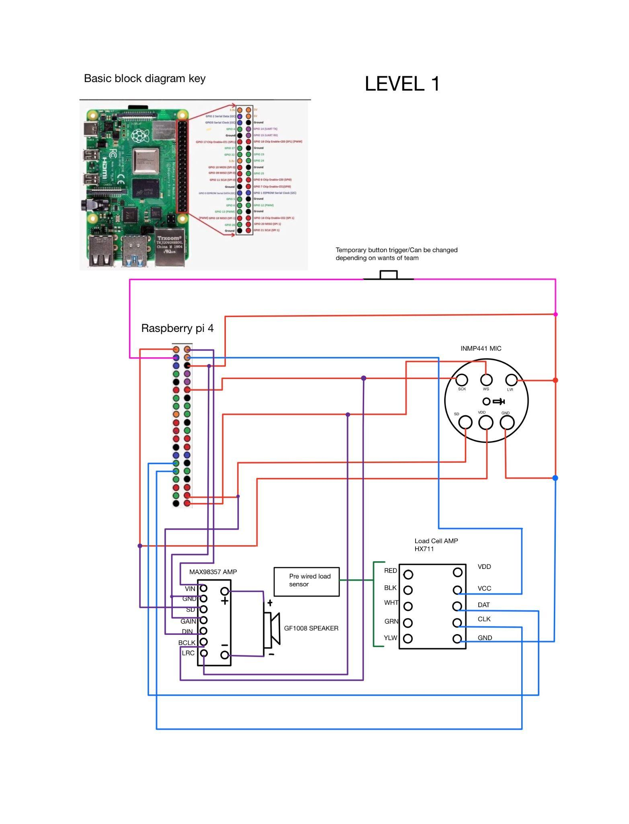
EE
Here is the level one schematic.
Key notes for cs team:
The entire driver code must be entirely sequential. At no point for this level of the SmartBin can we have two operations happening simultaneously. Although the processing power of this control unit is sufficient for multitask processing, the schematic design requires single task processing. The recording microphone and indication speaker are feed to the same ports. As long as the software dictates the RP4 changes modes in between components, it should function.

Slide 32
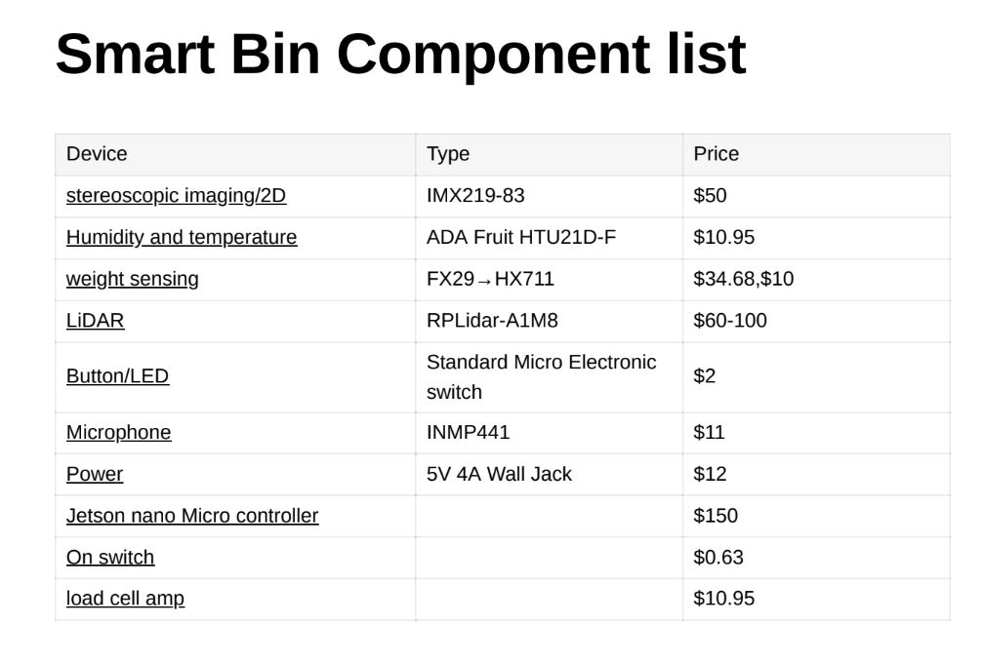
Ryan/ Mohan
Parts have been ordered and already began to show up! The last part that should get here (IMX219-83) will be on Friday. Assembly has officially begun!
Here is a list of the components we decided to go with and their serial numbers and prices. After meeting with Aiden, Jack and Daniel.

Slide 33
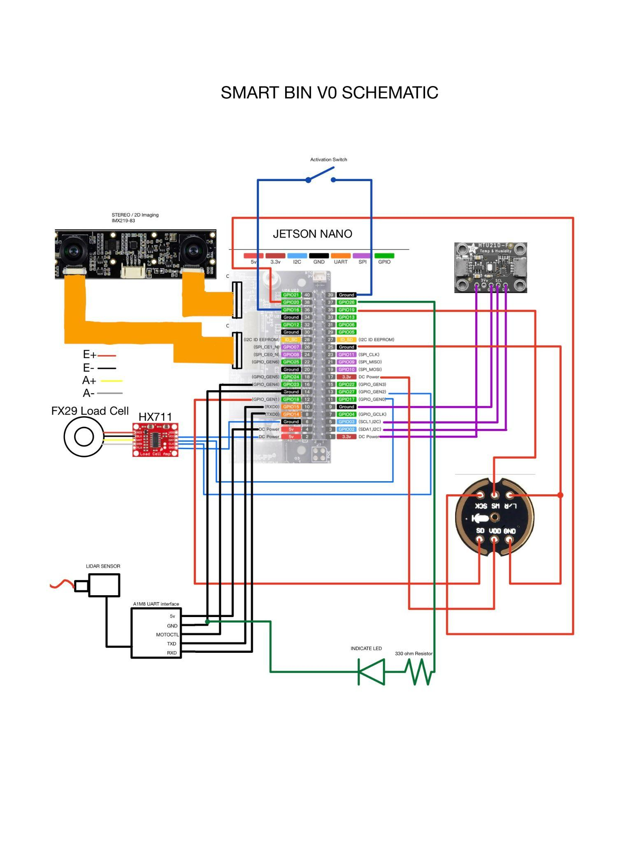
Current operation procedure (Cascade + Clark team)
Ryan - Is assembling hardware, waiting on some parts still. Assembly has already made some leaps and bounds, and here is the updated schematic I made based on the needs of the FFAR and the Cascade team.
Mohan - Sensor Validation, Base Scripts to make sure the hardware is functioning correctly at baseline. The Load cell, Load cell amp, and indication systems have been verified.
Aidan/Dev team- Final decoding of hardware program to behave as desired
Jake and Daniel - Housing for all of the hardware to be 3D printed.
The goal is to have 6 prototypes by the end of july.

Slide 34
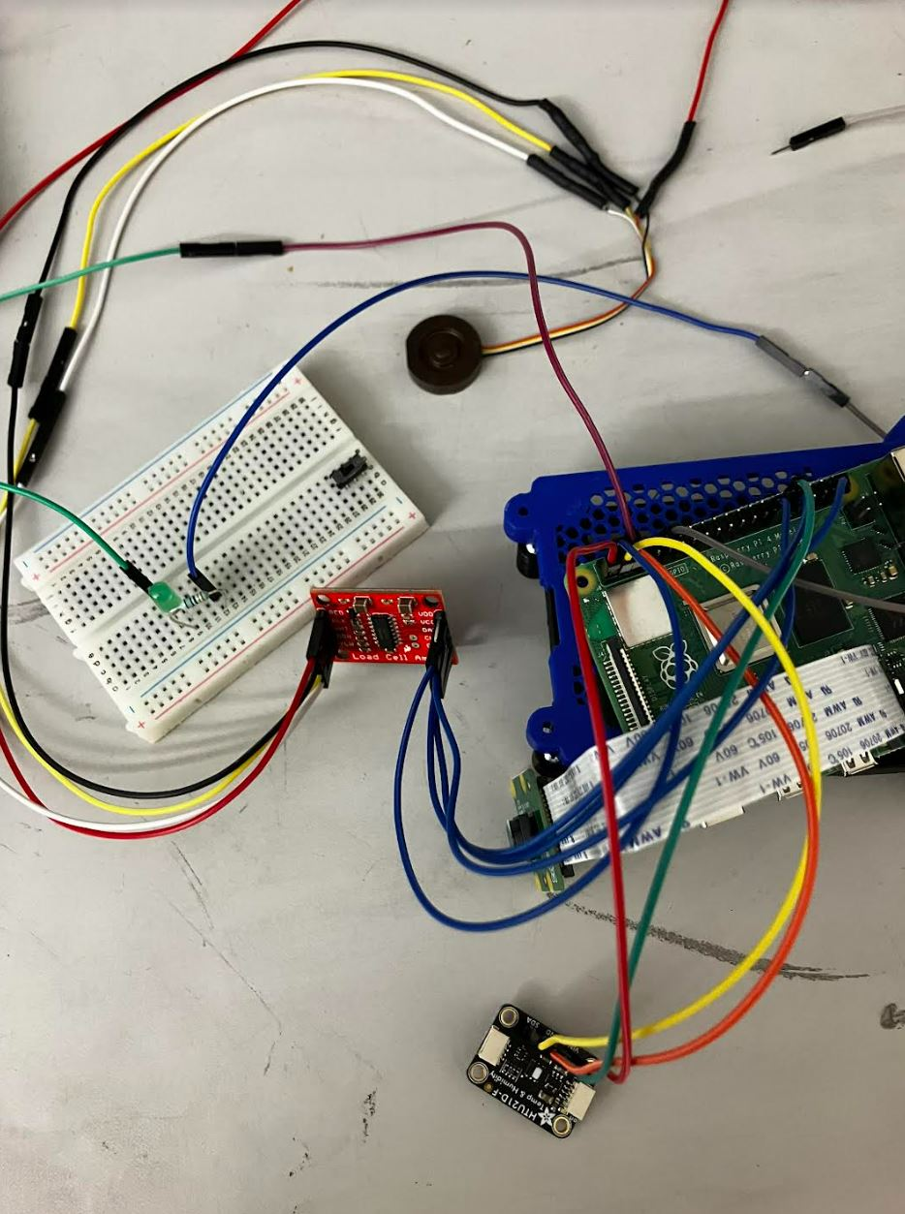
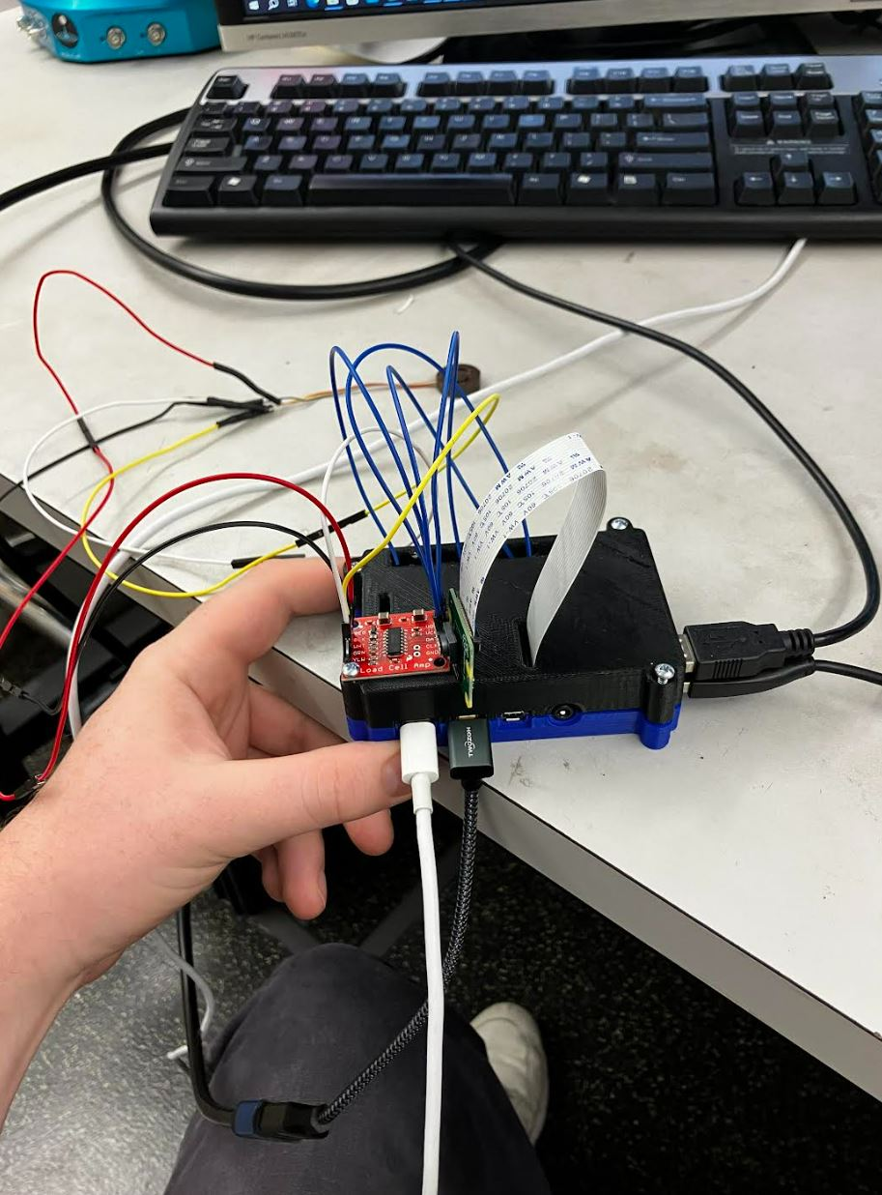
Components we have
FX29 Load cells (found on request of cascade team)
Load Cell Amp
Switches
Jumpers and Breadboard
RP4 Power supplies
Temp/pressure, LED,
Jetson nanos - Arrived Today at 11:40 am 7/19/23
Ordered but still waiting on arrival-
INMP441,
LiDAR,
Stereoscopic imaging system.
Power supply for jetsons
EE

Slide 35
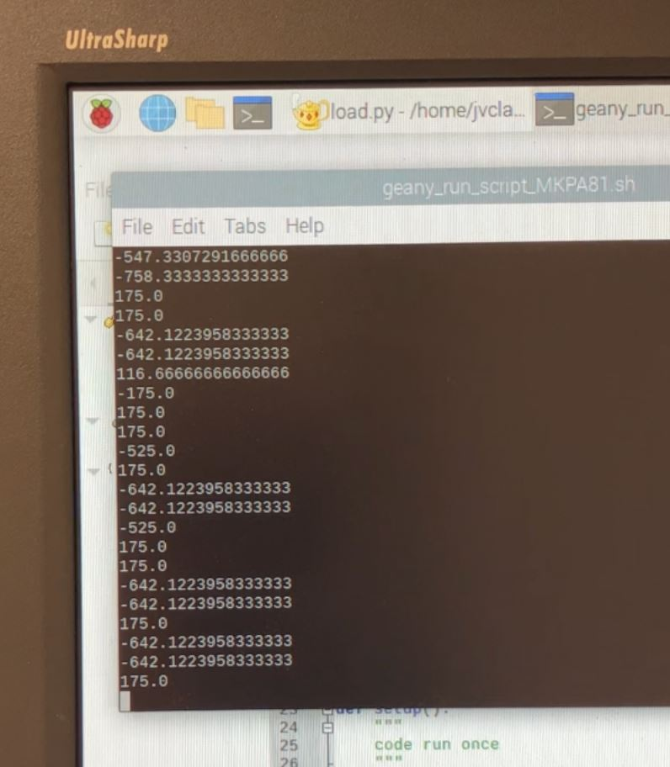
Mohan
Sensor verification as requested by the cascade team we have been verifying sensors as they come in to our left we have a running list of sensors that have output correctly on a general microcontroller
Here is the load cell
Proof of concept
VALID OUTPUT!!
Proof of sensor function
HX711
FX29
Indication system
Currently being tested
Temp/Humidity sensor
Waiting for rest of sensors

Slide 36
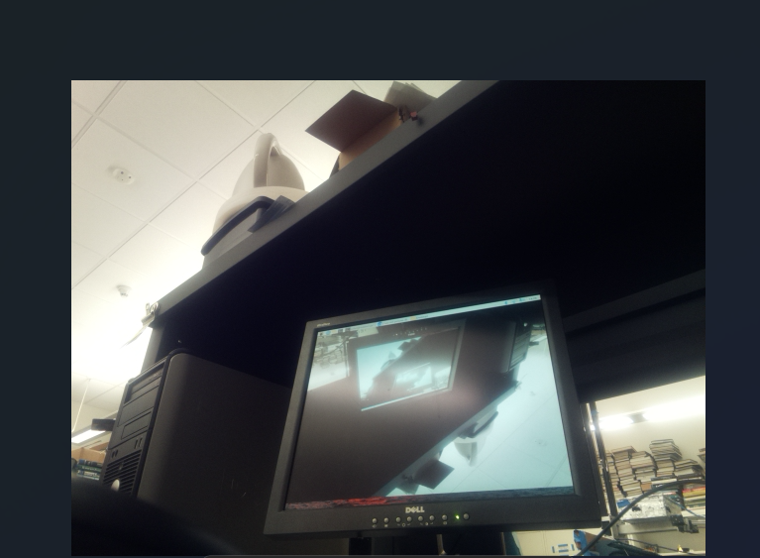
Got the camera module working and the embedded module is now able to capture pictures for required interval of times.
Got the Humidity sensor embedded.
work in progress to collect data from the sensor.
Working on more efficient scripts for the camera module and other sensors.

Slide 37
Mohan

Slide 38
July 5, 2023
Summer Meeting 2

Slide 39
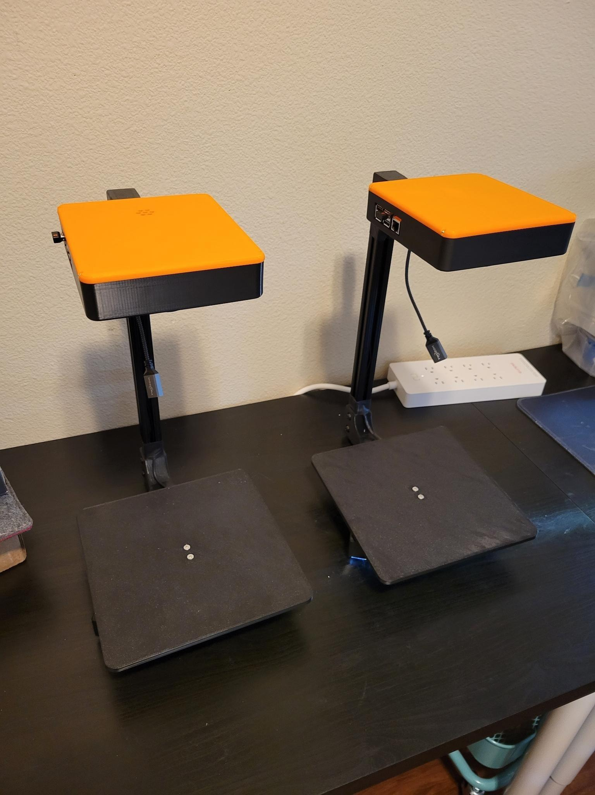
CS Team
Cloud Team
AWS IAM Management
Cafeteria Food Waste Autopsy (Micah)
Identify running services
Document processes on EC2
Commercial Food Waste Device V3
(Daniel/Jake)
Investigating new coprocessor
May move to Jetson for onboard AI
Design user init button
Handle load cell taring
Handle on/off GPIO flush
Remove ultrasonic sensor
Structural upgrades & changes
Investigate stereoscopic imaging solutions
StereoPi
Intel RealSense
Investigate LiDAR
Garmin LiDAR Light
V4 - LED
V3 - laser
Depth mapping solutions
UX Improvements
Speaker, LED indicator
User Display

Slide 40
CV Team
Identified relevant dataset ⇒
Roboflow Food Waste Detection Data set:
Interesting, because the images are of actual food waste.
Bounding boxes are present to differentiate different food items in a single picture.
Bounding boxes look very tight.
39 different classes where same food item might have various forms of waste, example: egg waste can be egg shell, yolk, scrambled, whole, boiled, etc.
7,622 total images, 7.4k train, 261 valid, and 2 test. (When I look into ‘Dataset’, there are different versions of data); can be downloaded in different data formats.
6 classes are over represented – bone, vegetable, egg-shell, orange, orange peel, and apple with over 600 images.
10 more classes with >100 images, 15 classes under represented with <20 images.

Slide 41
Lit Team
Objective 1:
Systematic Literature review of Studies Measuring FLW (literature collection, organization, and analysis) - perform an exhaustive literature search to identify all academic studies measuring home food loss and waste (FLW), document these measurements in a spreadsheet and organize data.
To inform landscape study: We will perform a landscape study with specific attention to gaps in literature
Quantification and Data Accuracy (there is a need for the development of more robust and accurate techniques for the quantification of household food waste).
Region and Socio-economic Diversity (demographic makeup of participants in each prior study)
Waste Composition (specific types and amounts of food being wasted need to be understood better.
Knowing whether waste is primarily consisting of perishable fruits and vegetables, meat products, or packaged goods can provide insight into possible interventions).
Contextual Factors (household size, urban versus rural location, cultural habits, and dietary preferences, government assistance, etc).
Behavioral Insights (behaviors and attitudes towards food waste is essential for devising effective strategies for waste reduction).
To inform cross-study normalization of measurements
To inform journal articles and educational pieces

Slide 42
Lit Team
Identified guiding research questions
Zotero workshop for undergraduates
Located databases and search terms to find articles
Working towards a final excel skeleton for data collection
Both students created a sample excel spreadsheet with data points
Janita is working towards merging both excel files
M and valeria’s accomplishments:
Finished initial readings i.e., proposal, “Missing Food? Missing Data”, and Literature Search Data Collection Criteria
Worked on creating an excel spreadsheet for data collection
Started recording existing literature on household food waste
Valeria is responsible for data collection from 2017-2023 and M is responsible for 2010-2016

Slide 43
Smart bin companies worldwide
Company | Bin Name | Cost of the bin | Links
Winnow | 6 types – 3(Non-Ai) and 3(AI ) | $300 - $600 per month
Kitro | Kitro – only 1 type | Subscription model, Have to find | https://www.kitro.ch/product
Orbisk | Orbi | Have to find | https://orbisk.com/ https://www.youtube.com/watch?v=2yGu2k6RwKA&ab_channel=Orbisk
Lumitics | Insight and Insight lite | Have to find | https://www.youtube.com/watch?v=zd2GOpsLFaU&ab_channel=CNAInsider

Slide 45
CS
EE
AG
…
…
…

Slide 46
June 28, 2023
Summer Meeting 1

Slide 47
First Meeting
Introductions
Overview of Teams
Weekly meeting expectations
Meet all together Wednesdays at 2
Give subteam-level updates (<10 min)

Slide 48
Project Overview
important and pinned slides

Slide 49
Background
Smart Compost Bin
This request for applications (RFA) aims to accelerate the development of an innovative methodology (technological [e.g., an app] and/or non-technological [e.g., kitchen diaries]) for regularly occurring quantitative measurement of food waste generated in US households that can be used by stakeholders across the food system. A key component of developing such a measurement methodology is access to and collection of quality data, which, in turn, requires effective data management. Establishing such a methodology would require the collaboration of researchers and practitioners across multiple sectors and disciplines.

Slide 50
Abstract
Smart Compost Bin
Current approaches to measuring home food waste are burdensome on the consumer and prone to human error. This remains a barrier to widespread deployment of such approaches for systemic measurements of consumer food waste. We propose a cyber-enabled technology that automatically and precisely measures food waste designated for compost in the consumer household. We adapt a typical kitchen compost bin to include a weight scale and controller to accurately measure all edible and non-edible food waste discarded in a household kitchen. By adapting technology to users’ existing habits, we avoid requiring consumers to change their behavior or perform additional tasks.
We propose a smart compost bin to collect and measure food waste in the home consumer kitchen. Our device will weigh the bin each time a user discards waste, creating an accurate and systematic log of waste discarded. Our prototype also contains other tools to enable food waste research with machine learning, including Wi-Fi for uploading data, microphone for recording descriptions of waste discarded, LiDAR sensors to estimate volume, and stereoscopic cameras to collect images to enable future food waste measurement technologies using computer vision.
By innovating a way to measure food waste at the household-level that does not require undue burden on the user, we expect our system to facilitate large-scale and systematic studies measuring food waste. Additionally, the measurements collected by our system will support future applications and visualization tools that provide data-driven and personalized interventions to empower individuals to reflect upon and change their food waste habits.

Slide 51
Objectives
Smart Compost Bin
OBJECTIVE 1: Compare existing home food waste studies. We will perform a landscape study of the related food waste measurement approaches to best inform our design and our pilot study.
OBJECTIVE 2: Design a consumer-friendly smart bin to measure compost in the kitchen. We will design and iteratively refine hardware and software interfaces for usable, efficient, and flexible technologies to weigh, photograph, and log kitchen compost.
OBJECTIVE 3: Perform a case study to compare our approach with traditional approaches. We will perform a small pilot study to rigorously test our device, validate our measurements, and assess the potential to scale this approach.
OBJECTIVE 4: Disseminate novel datasets about home food waste. We will disseminate novel datasets of food waste measurements, containing associated weights, LiDAR, images, and brief text description of the compost waste, to enable novel food waste research.

Slide 52
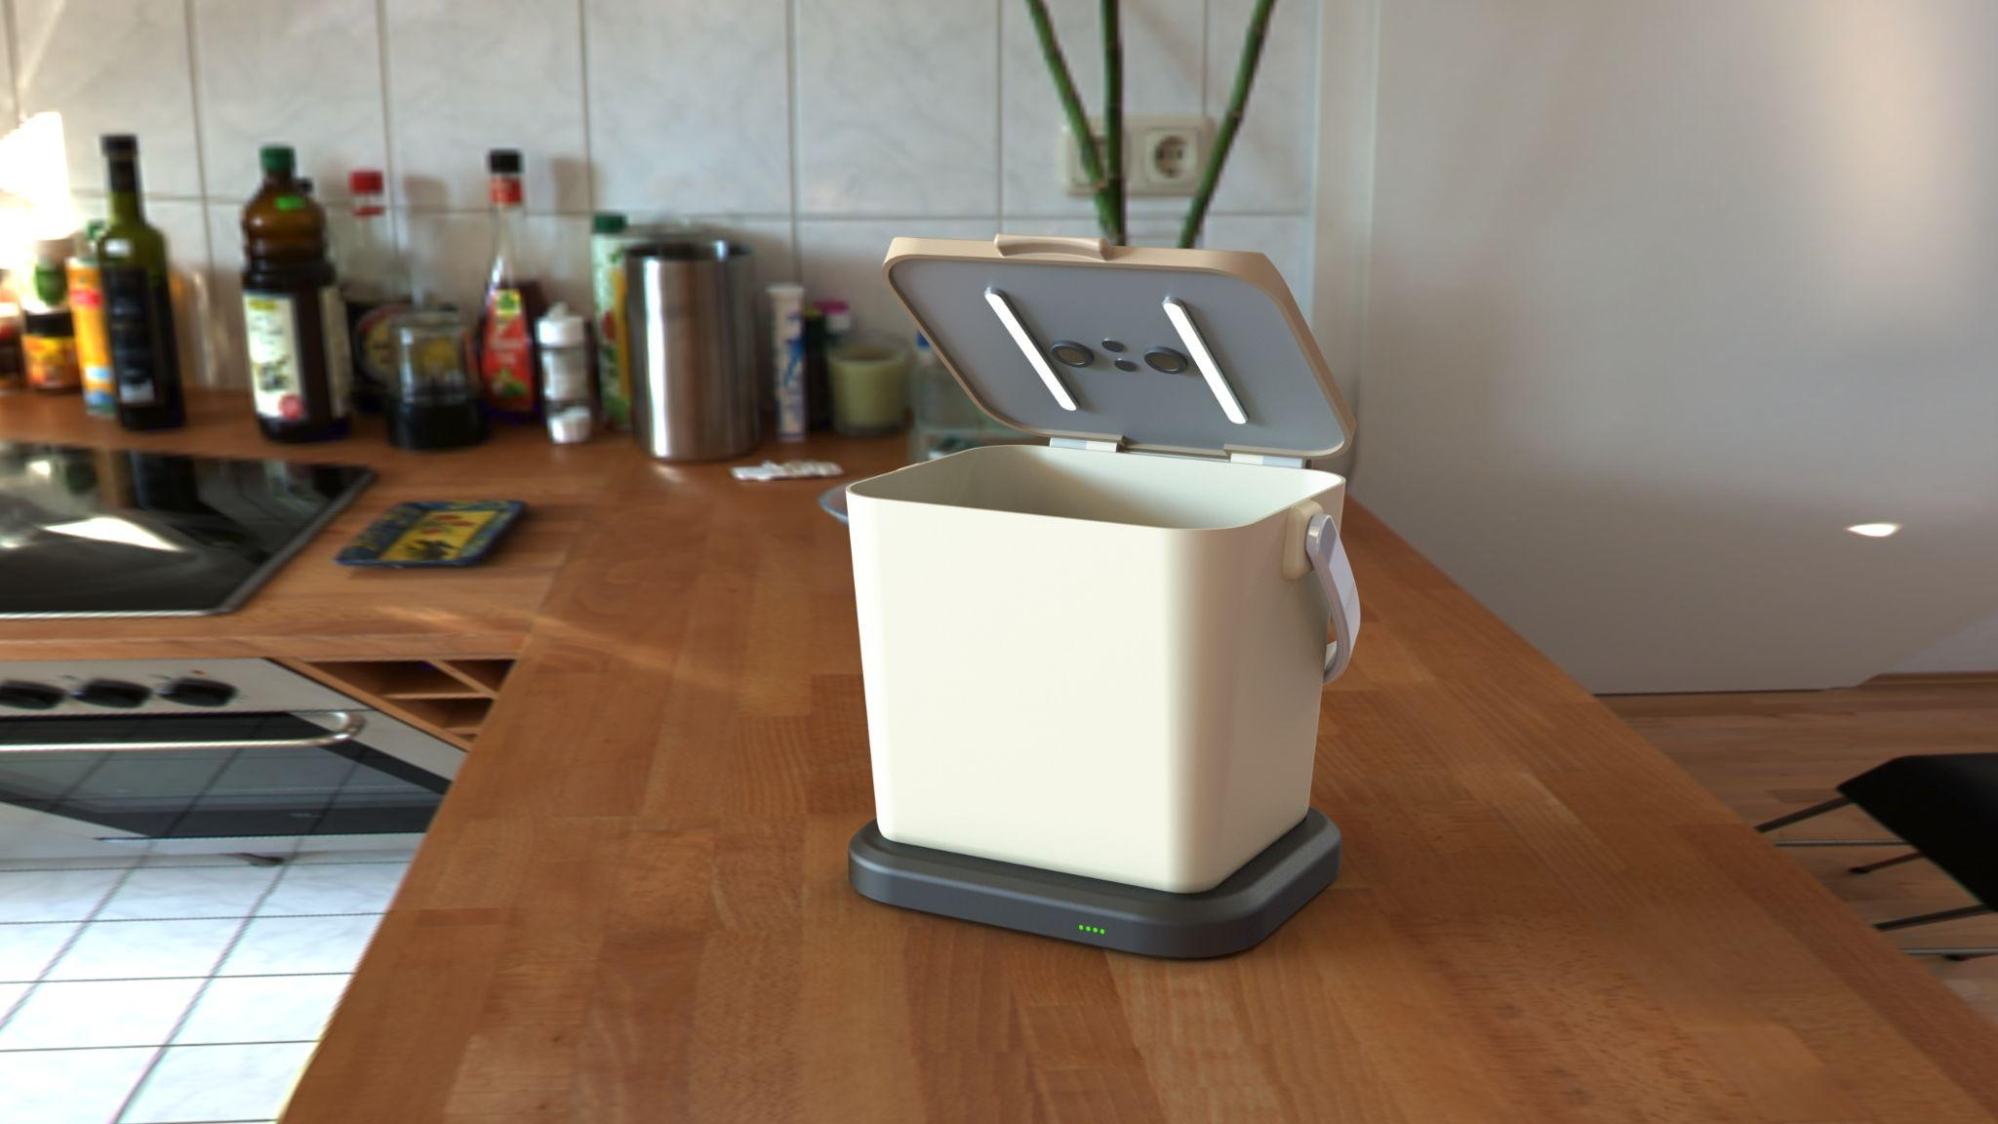
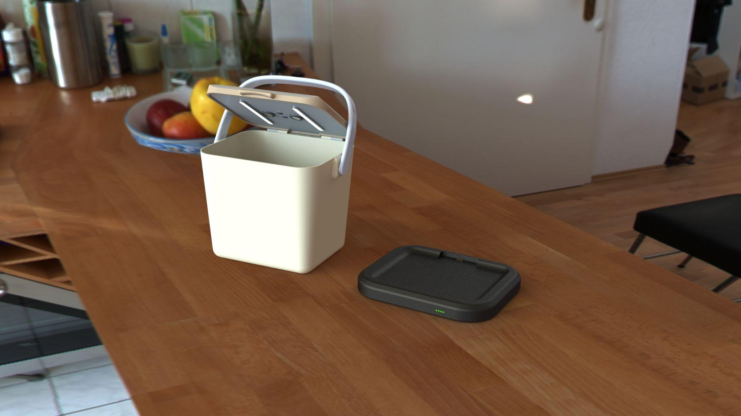
Example render of hypothetical design

Slide 53
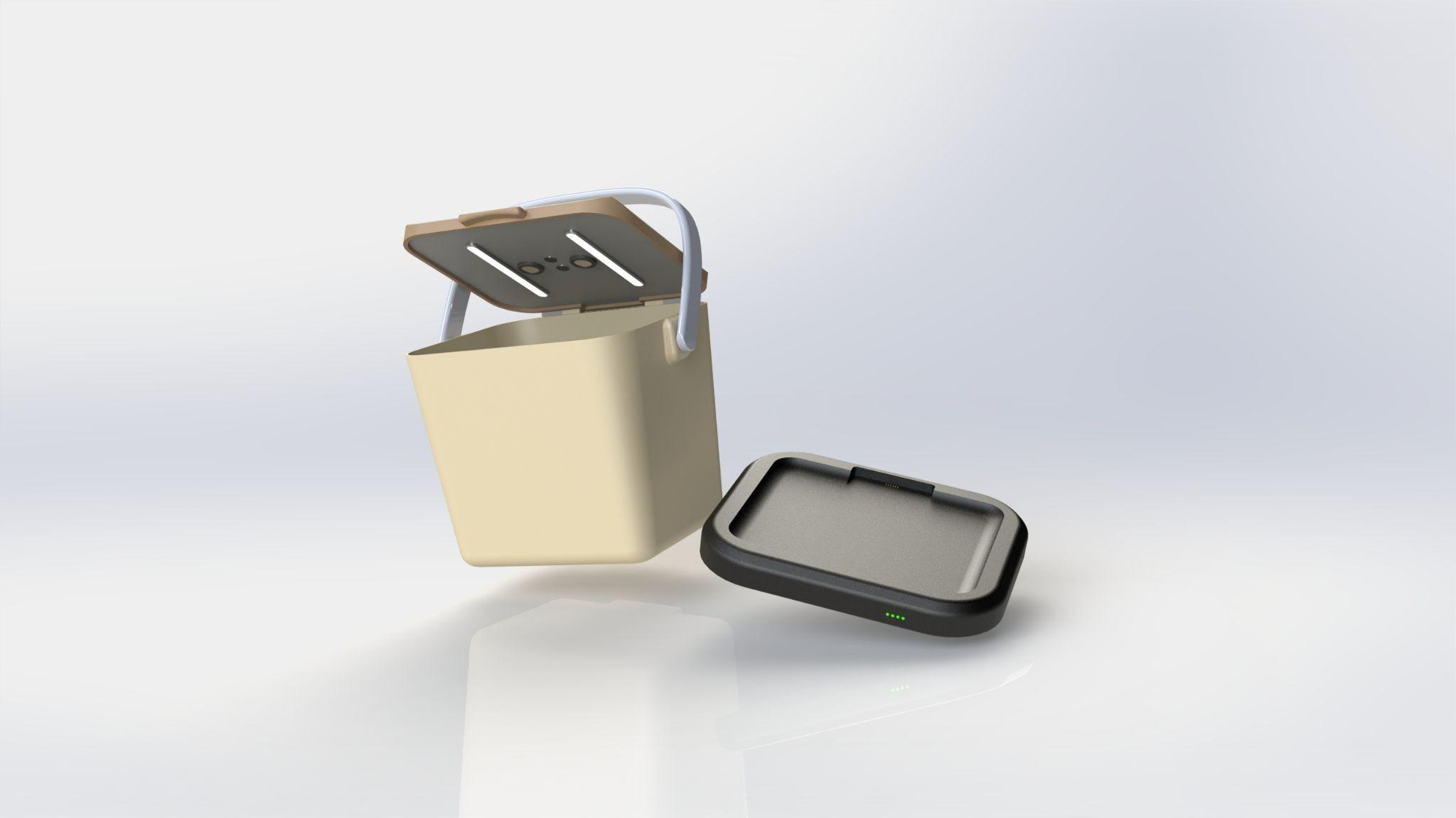
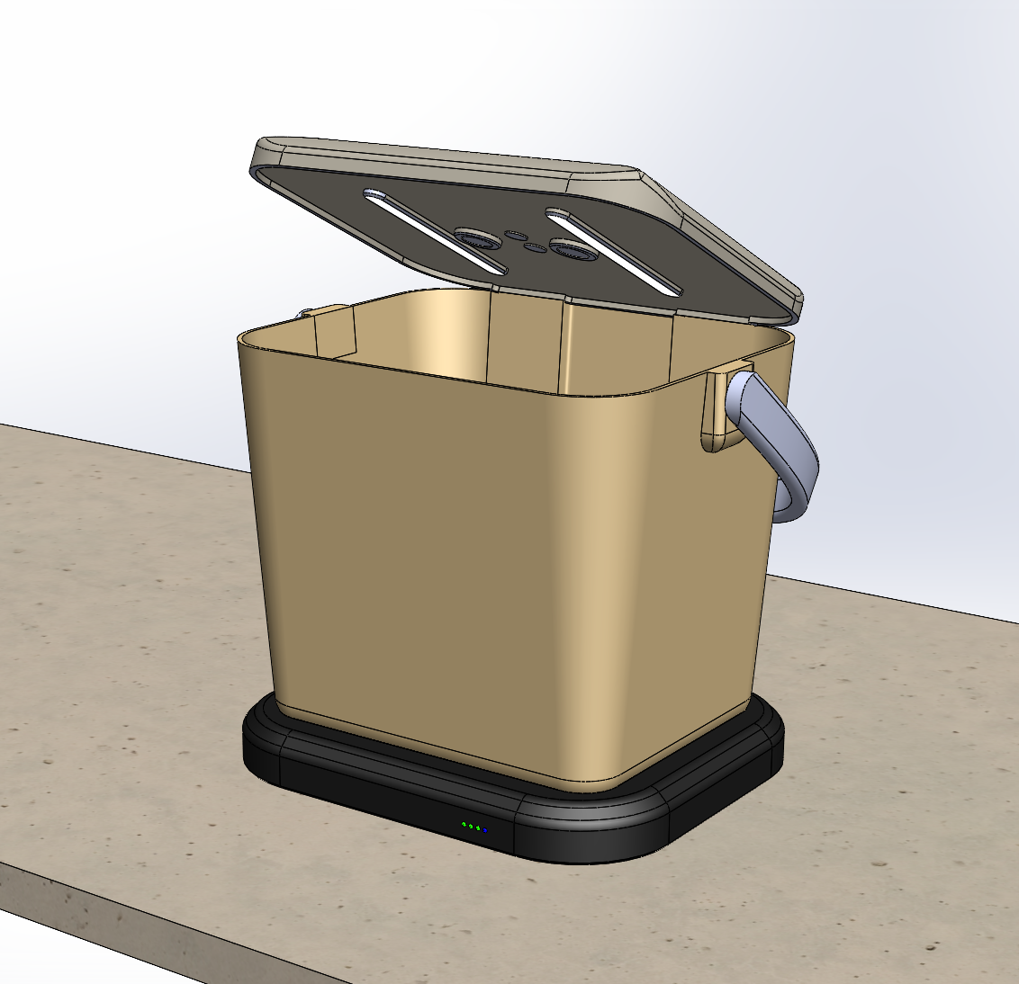
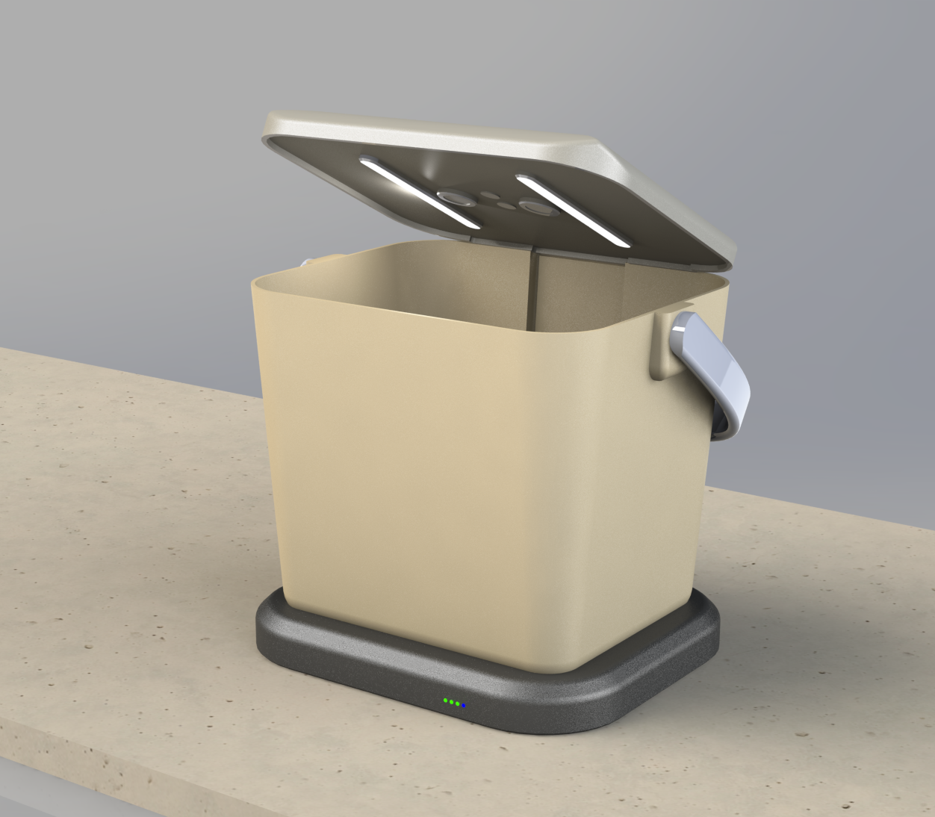
Example render of hypothetical design

Slide 54
 |  | Quarter
Objective 1: Perform comparative analysis of home food waste |  | Q1 | Q2 | Q3 | Q4 | Q5 | Q6
 | Identify direct measurement and journal FLW studies | • | •
 | Perform comparative meta-analysis |  | • | •
 | Disseminate review paper |  |  |  | •
Objective 2: Design and build smart bin to measure kitchen compost. |  | Q1 | Q2 | Q3 | Q4 | Q5 | Q6
 | Design prototype | • | • | •
 | Iteratively test and refine prototype |  |  | • | •
 | Manufacture prototypes for study |  |  |  | • | •
Objective 3: Perform a pilot study to collect waste measurement |  | Q1 | Q2 | Q3 | Q4 | Q5 | Q6
 | Design pilot study informed by landscape study |  |  | • | •
 | Perform pilot study |  |  |  |  | • | •
 | Analyze results and disseminate findings |  |  |  |  |  | •
Objective 4: Prepare and disseminate novel datasets |  | Q1 | Q2 | Q3 | Q4 | Q5 | Q6
 | Organize, aggregate, and process data |  |  |  |  | • | •
 | Disseminate dataset of FLW weights, images, and LiDAR |  |  |  |  |  | •

Slide 55
PROJECT TIMELINE
Goals
Quarters 1 & 2
literature search [O1]
design prototype [O2]
Quarters 3 & 4
meta-analysis [O1]
test prototype [O2]
design study [O3]
Quarters 5 & 6
deploy study [O3]
process data [O4]

